Slide 1

Cash me outside
Data Mining and Text Mining – A.Y. 2016/2017
Dimitar Anastasovski 852366
Petar Korda 852627
Pavle Vidanovic 854472
POLITECNICO DI MILANO

Slide 2

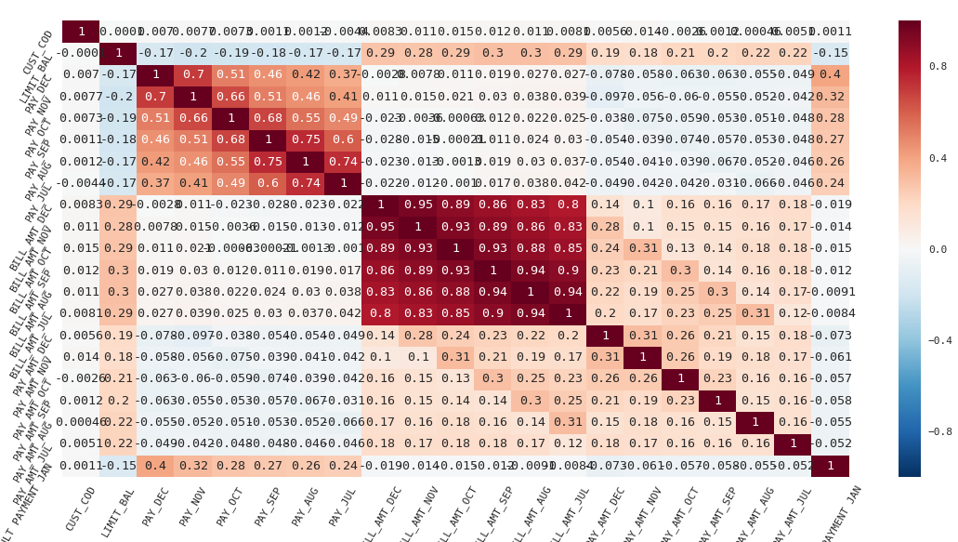
Data Exploration
Correlation Matrix for features
POLITECNICO DI MILANO

Slide 3
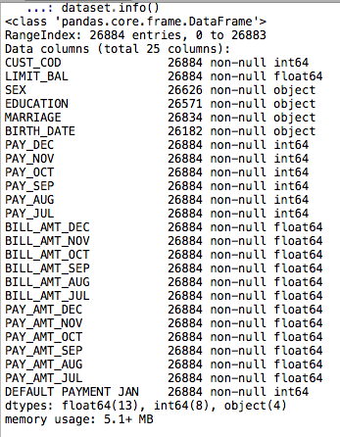
Preprocessing
Missing values policies - most frequent for categorical and median for numerical
Categorical data - LabelEncoding and OneHotEncoding
BIRTH_DATE - transformed into AGE
BILL_AMT features averaged by all months, and dropped all columns
PAY_AMT features averaged by all months, and dropped all columns
CUST_COD removed
Normalization - StandardScaler
POLITECNICO DI MILANO

Slide 4
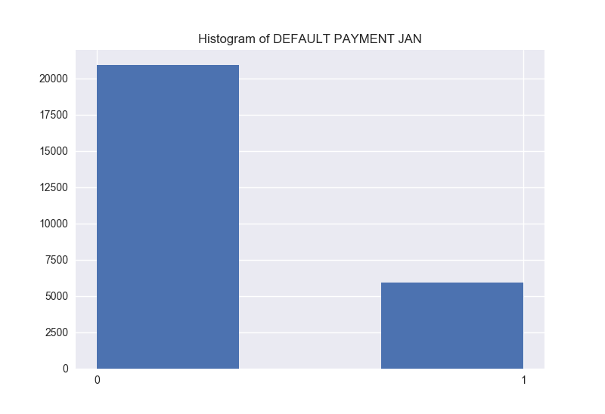
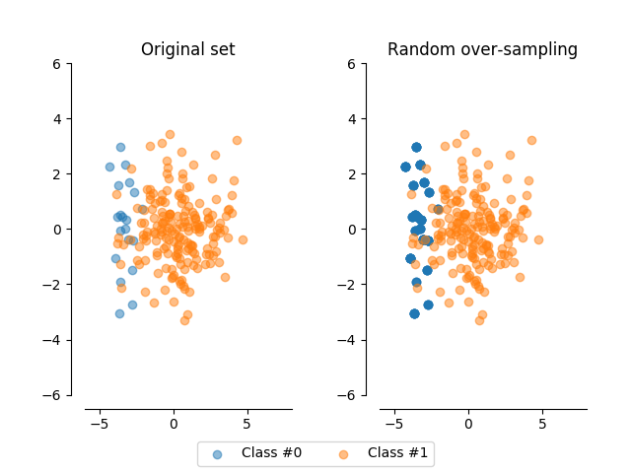
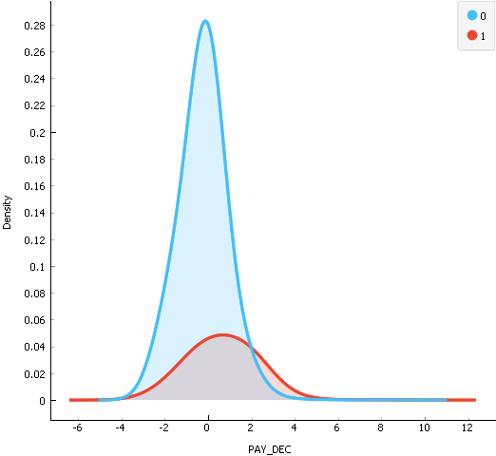
Preprocessing - Oversampling
Since we noticed that dataset is unbalanced we performed Oversampling technique
We oversampled minority class in holdout train set so we could have relevant prediction evaluation on holdout test set
Random Oversampling
POLITECNICO DI MILANO

Slide 5
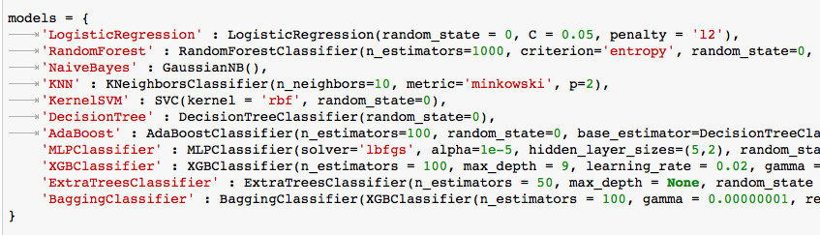
Model selection
Evaluation - Holdout 75%/25%
Highest f1 score - BaggingClassifier with XGBoost as base estimator
Parameter tuning - GridSearch
After Bagging Classifier best performances had LogisticRegression Classifier and MLP Classifier
POLITECNICO DI MILANO

